Slide 1

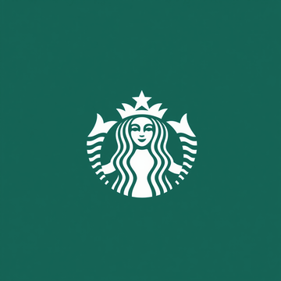

Starbucks
Welcome to Starbucks
Welcome to Starbucks, your ultimate destination for exceptional coffee experiences. At Starbucks, we believe in crafting moments of joy and connection through every cup of coffee we serve.
Next Slide

Slide 2
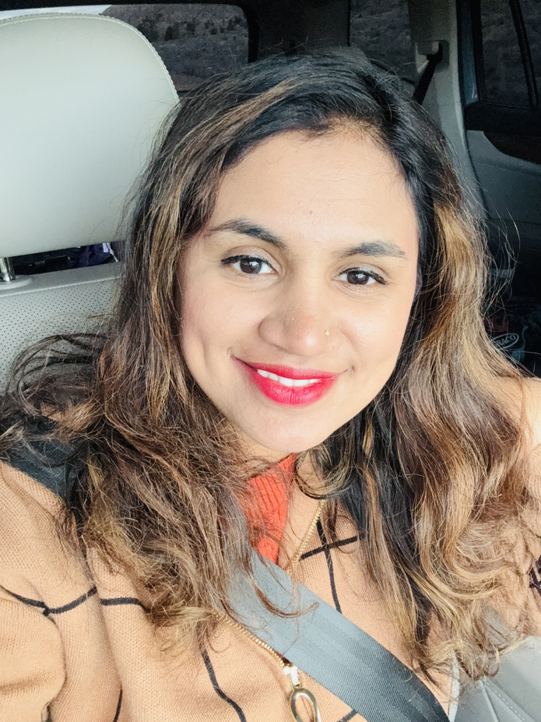
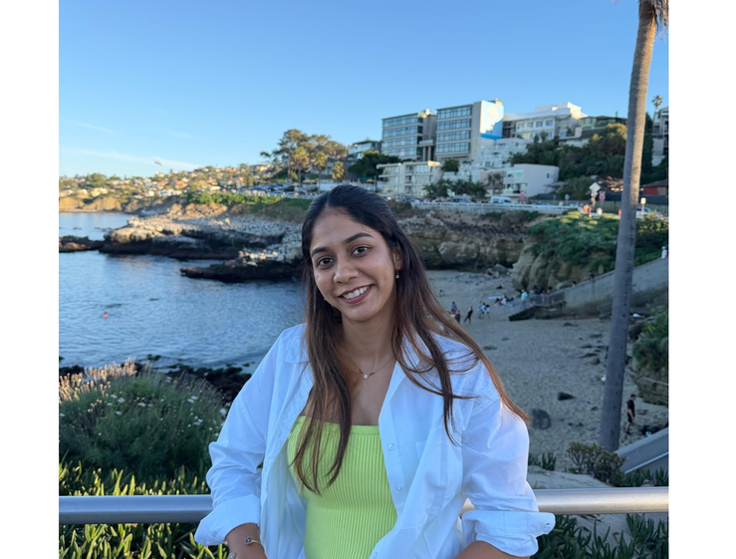

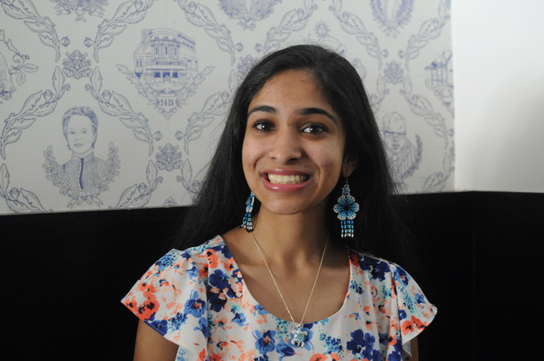
Starbucks
OUR TEAM
PRIYA
SANJANA
VARUNA
ASHRITHA

Slide 3
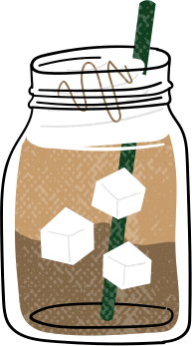
Starbucks
Starbucks
“In every coffee order lies data, understanding
customers means knowing when, how,
and why they choose their cup.”
Source : Starbucks Customer Ordering Patterns
Key Insights from the Dataset
From this dataset, we aimed to uncover three critical aspects:
When customers order — pinpointing peak demand periods
How they order — exploring various channels and levels of
customization
Why they order — understanding the factors that influence satisfaction
and spending

Slide 4



Starbucks
Starbucks
ER Diagram And
Relationships
This ER diagram maps the coffee journey (relationships)
Ready to brew up some knowledge? Let’s dive in!

Slide 5
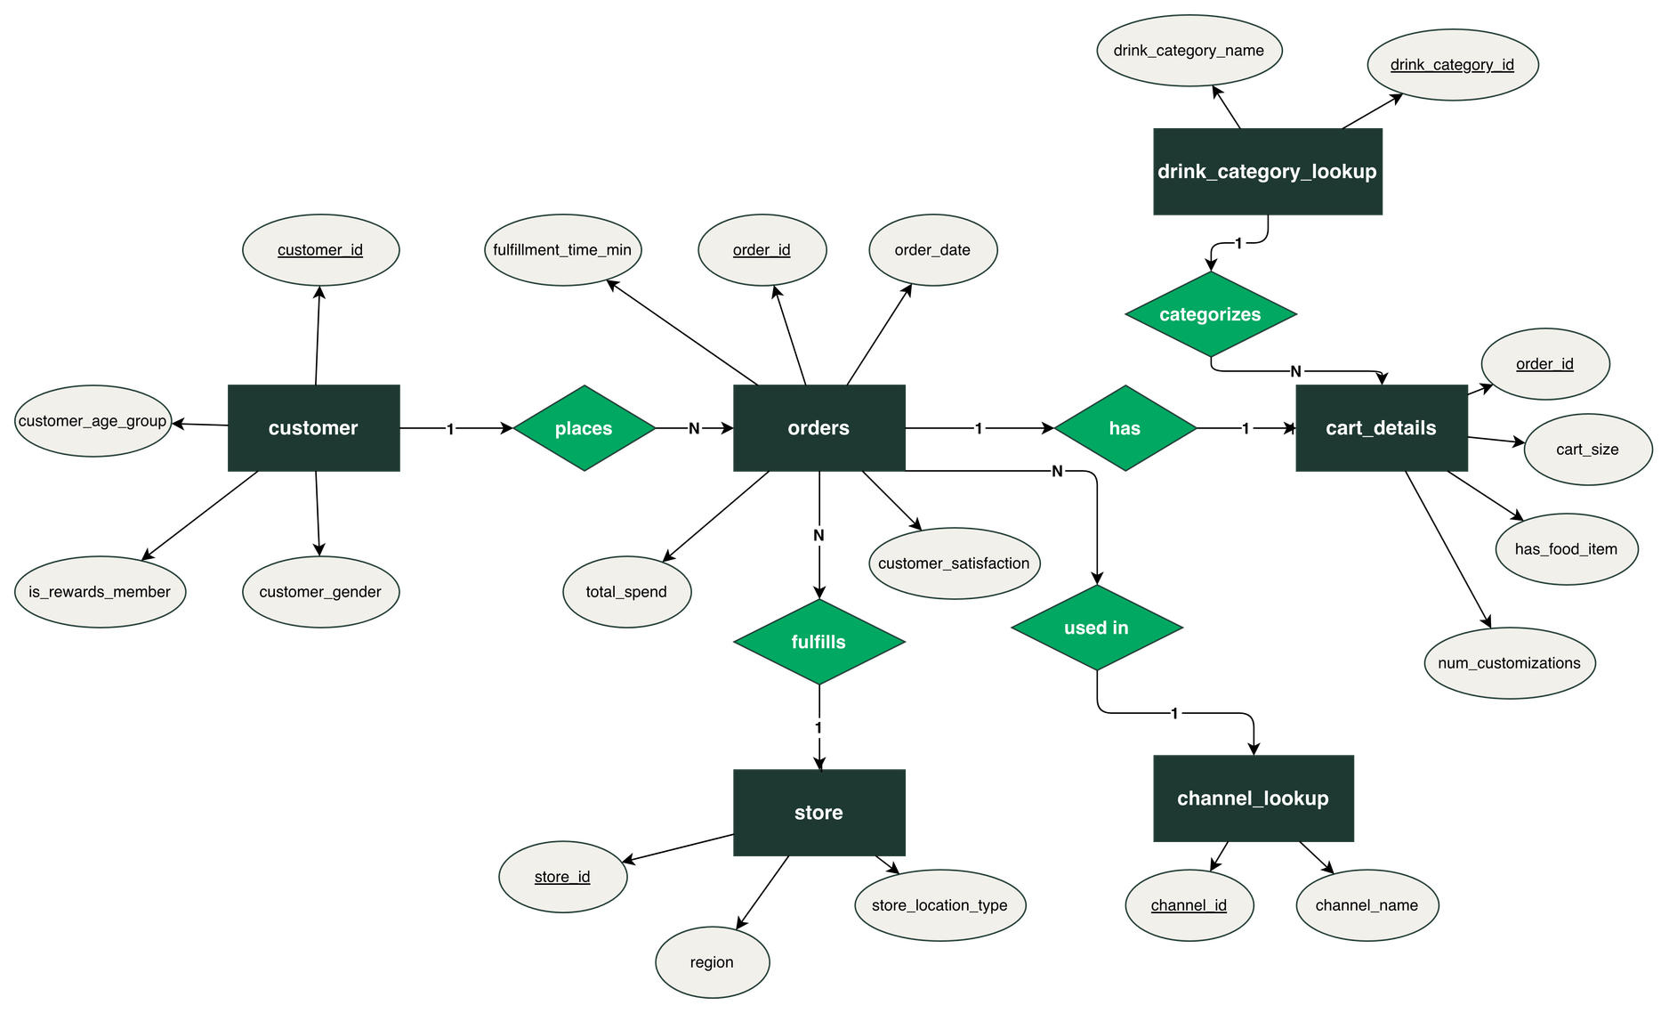
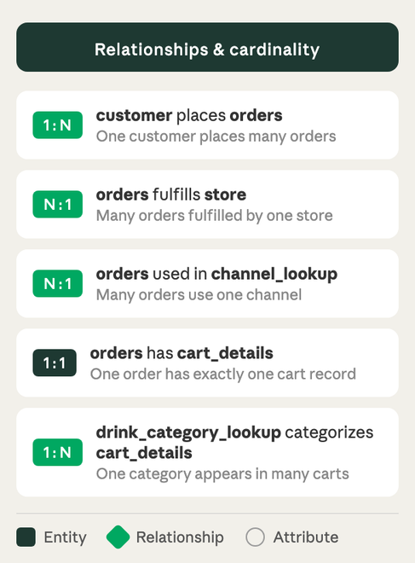
ER Diagram
Starbucks
Starbucks

Slide 6

Starbucks
Normalization
“We start with a messy cup of data (1NF), separate the cups for clarity (2NF),
and finally clean everything into a perfectly brewed coffee cup(3NF).”
Click Here

Slide 7
Borcelle
Starbucks
1NF
Ensure Atomic Values
OrderID (PK) | OrderDate | OrderTime | DaysOfWeek | OrderChannel | OrderAhead | StoreID | CartSize | NoOfCustomizations | TotalSpend | FulfillmentTimeMin | DrinkCategory | HasFoodItem | StoreLocationType | Region | CustomerID | CustomerAgeGroup | CustomerGender | IsRewardsMember | CustomerSatisfaction

Slide 8
Borcelle
Starbucks
2NF
Remove Partial Dependencies
👤 Customer = CustomerID (PK) | CustomerAgeGroup | CustomerGender |
IsRewardsMember
🏪 Store = StoreID (PK) | StoreLocationType | Region
📝 Order = OrderID (PK) | CustomerID (FK) | StoreID (FK) | OrderDate |
OrderTime | DaysOfWeek |OrderChannel | CartSize |
NoOfCustomizations | TotalSpend | FulfillmentTimeMin|
DrinkCategory

Slide 9
3NF
Remove Transitive
Dependencies
Borcelle
Starbucks
👤Customer = CustomerID (PK) | CustomerAgeGroup | CustomerGender |
IsRewardsMember
🏪 Store = StoreID (PK) | StoreLocationType | Region
📝Order = OrderID (PK) | CustomerID (FK) | StoreID (FK) | ChannelID (FK)
OrderDate | OrderTime |DayOfWeek | OrderAhead |TotalSpend
FulfillmentTimeMin | CustomerSatisfaction
☕Drink Lookup = DrinkID (PK) | DrinkName
📱Channel Lookup = ChannelID (PK) | ChannelName
🛒Cart Size = OrderId (PK) (FK) | DrinkCategory (FK) | CartSize |
NumberOfCustomization | HasFoodItem

Slide 10
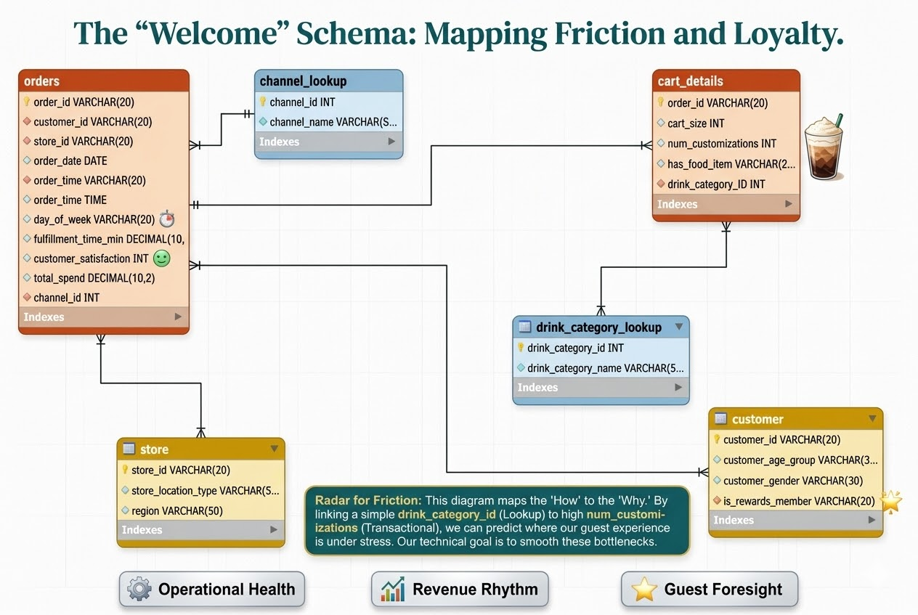
EER Diagram
Borcelle
Starbucks

Slide 11
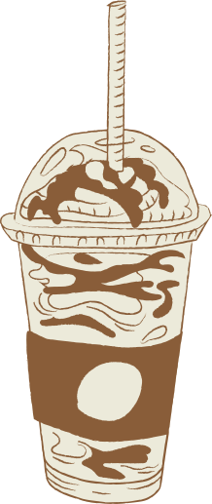
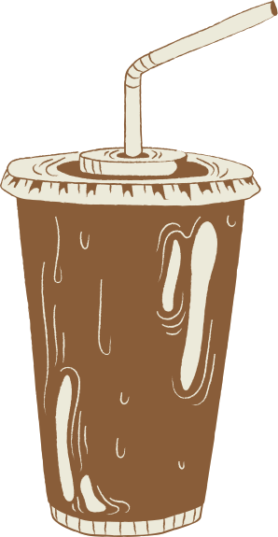
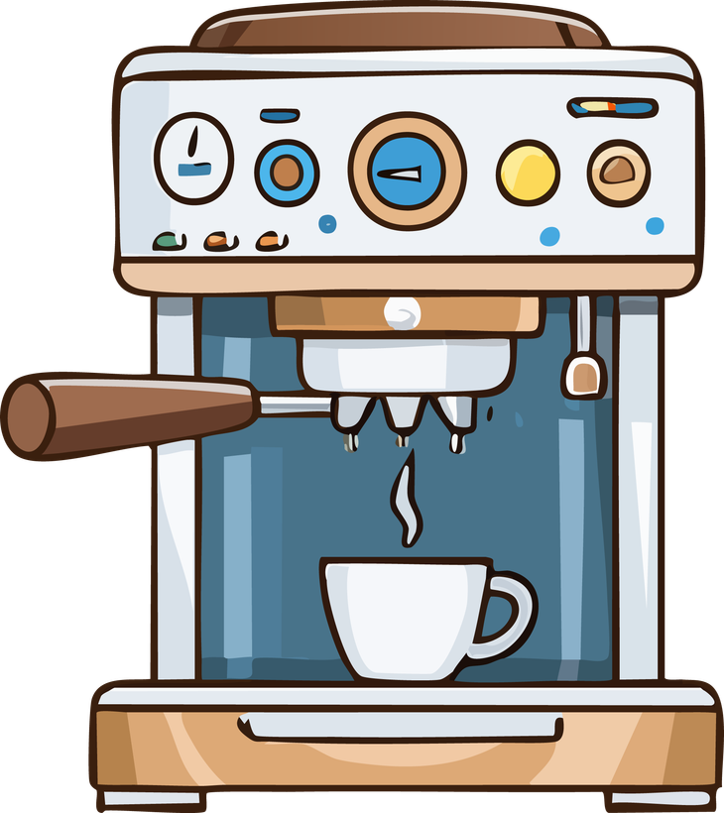
Borcelle
Starbucks
“Just like brewing coffee, SQL requires precision; the right grind, timing, and flow yield the perfect insight.”

Slide 12

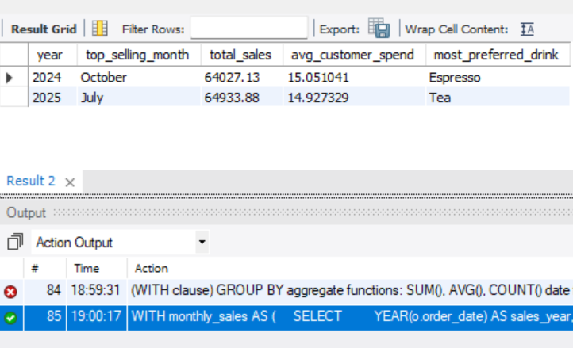
Borcelle
Identify the years present in the dataset, find the top-selling month within each year, calculate the average customer spend for that month, and determine the most preferred drink category.
Starbucks
Result

Slide 13
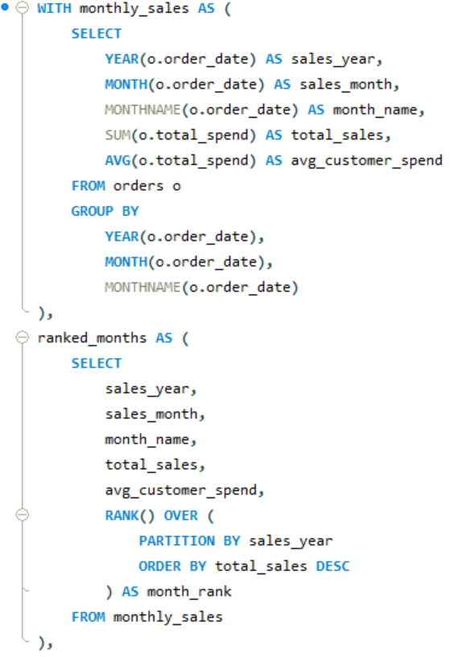
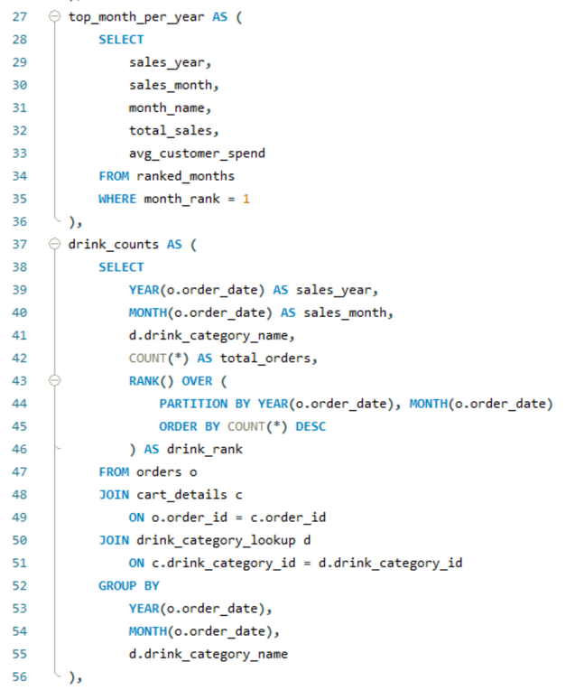
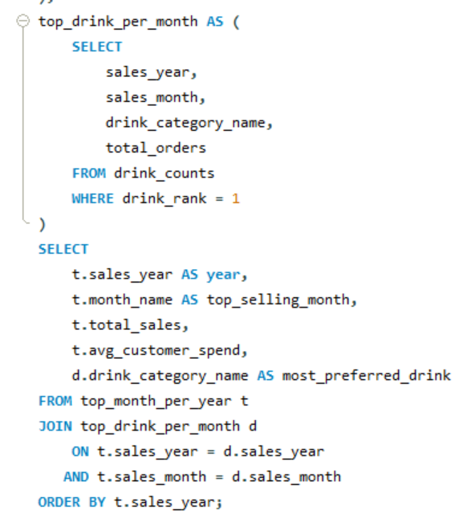
Borcelle
Starbucks
SQL Query

Slide 14

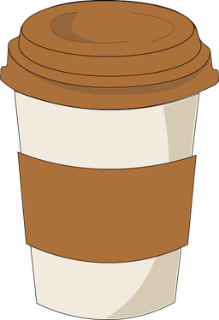
Identify the years present in the dataset, find the top-selling month within each year, calculate the average customer spend for that month, and determine the most preferred drink category.
Borcelle
Starbucks
2025
2024
July
October
Most Loved Drink: Tea
Total Sales: $64933.88
Avg Customer Spend: $14.92
Most Loved Drink: Expresso
Total Sales: $64027.13
Avg Customer Spend: $15.05

Slide 15
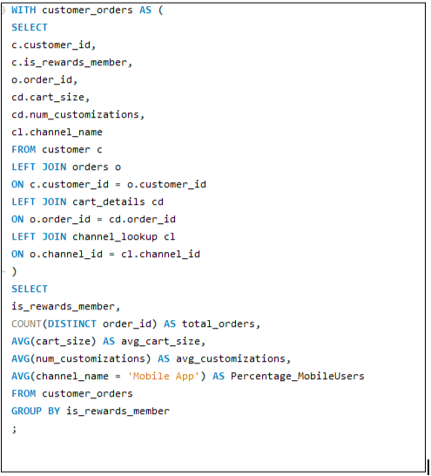
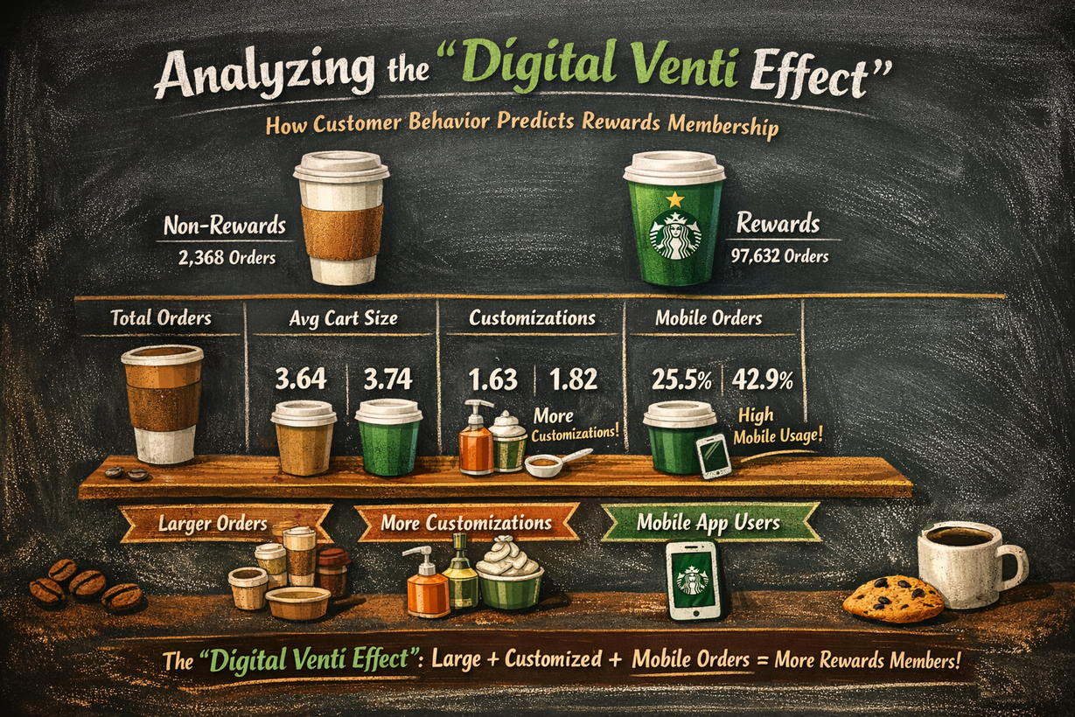
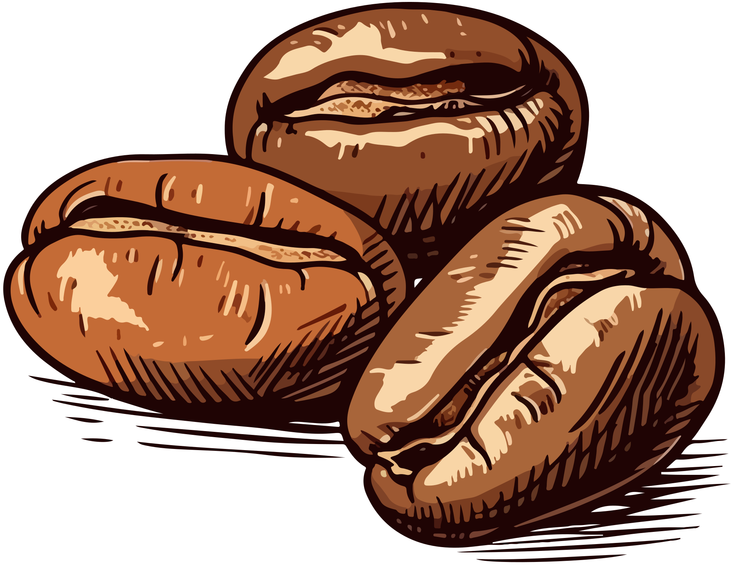
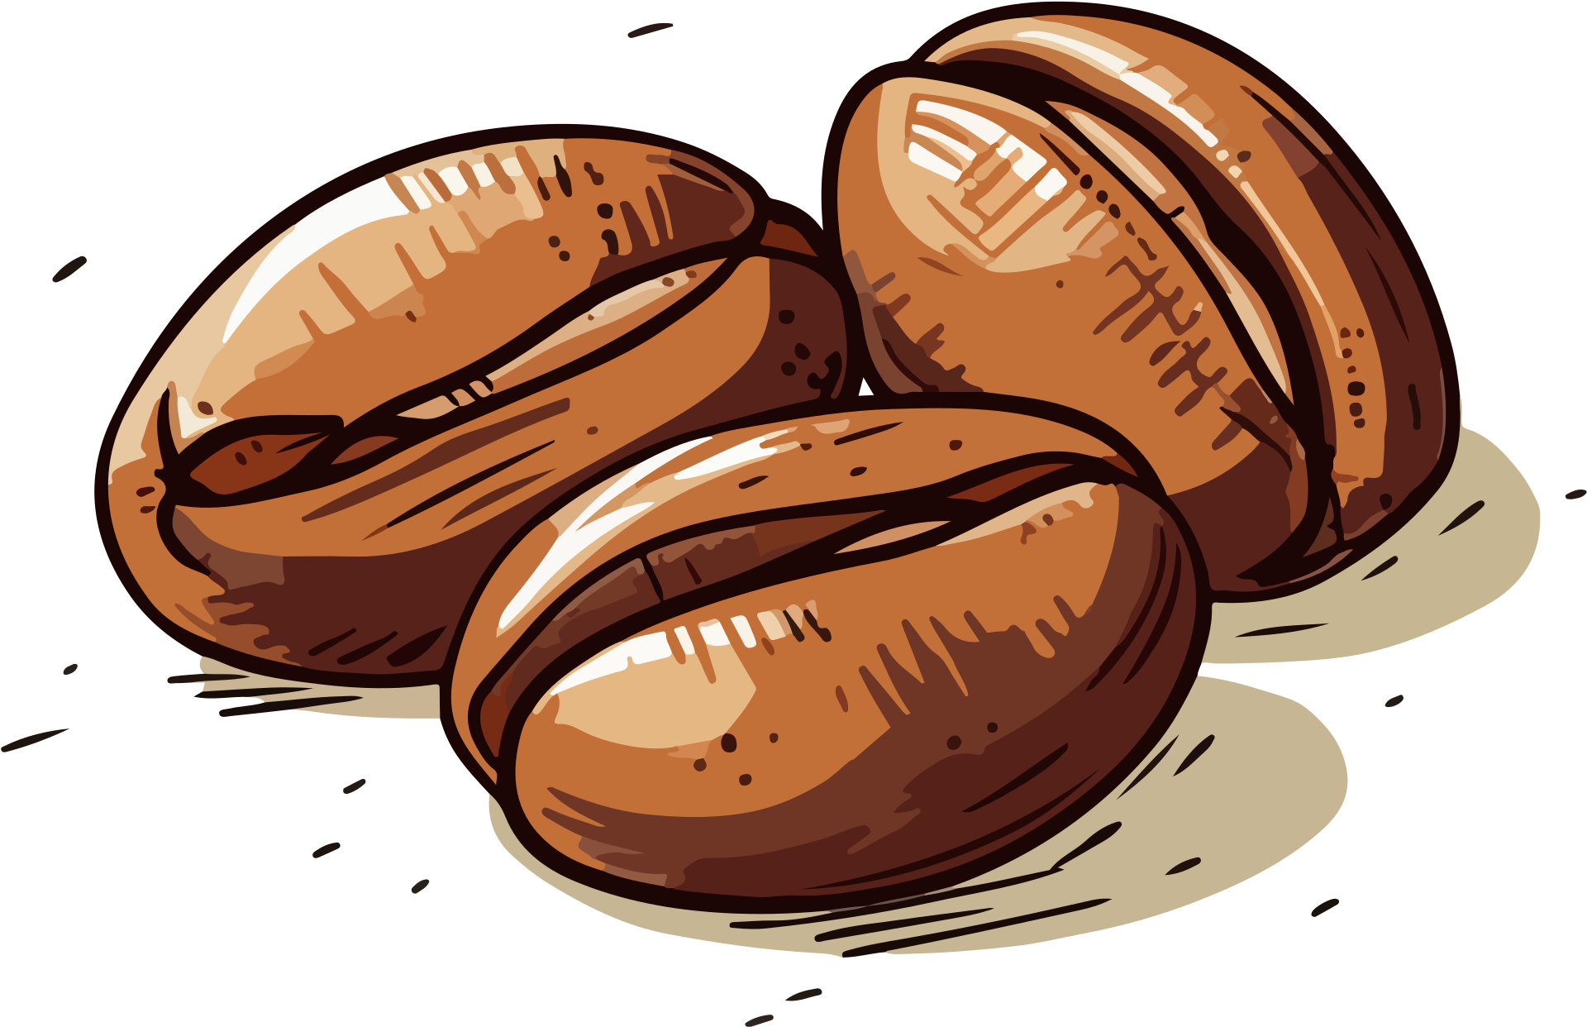

How do order behavior factors including order size, number of customizations, and order channel influence a customer’s likelihood of becoming a Starbucks Rewards member, and how does this relate to the Digital Venti Effect?
Borcelle
Starbucks

Slide 16
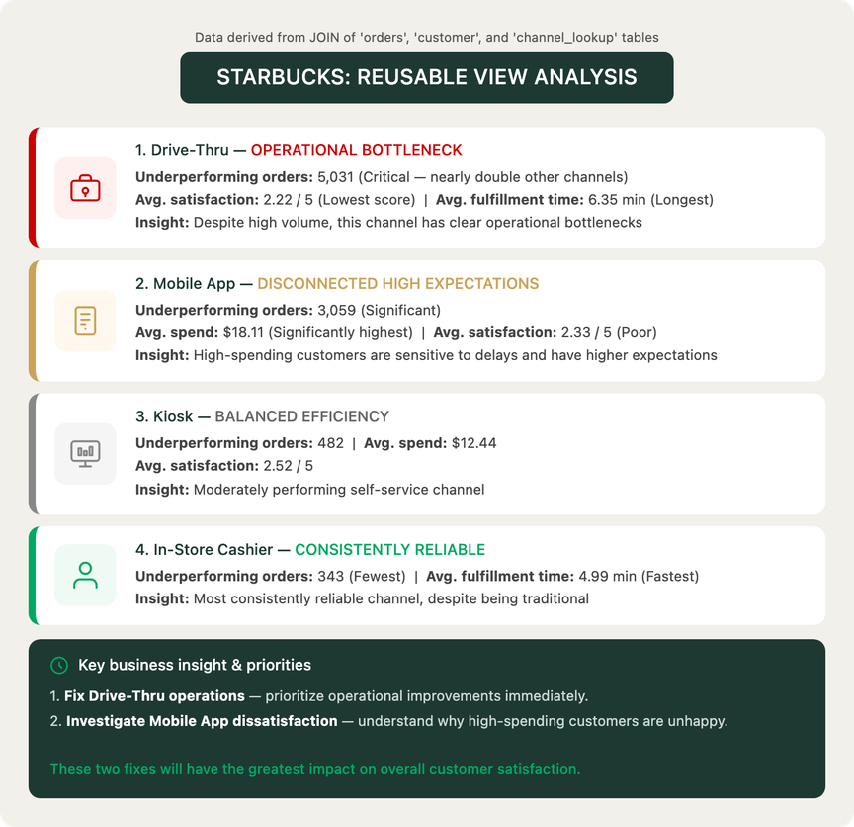
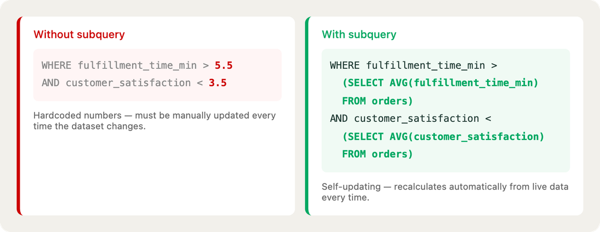
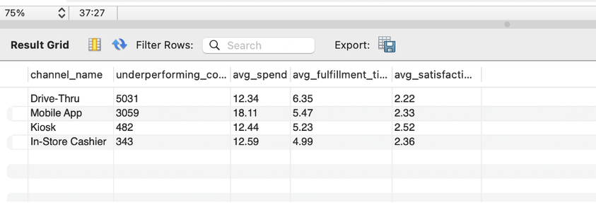
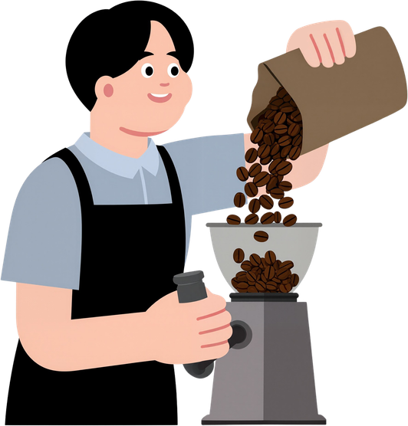
Query Objective: Identify Starbucks channels where wait times and satisfaction scores both underperform in order to prioritize operational fixes.
Borcelle
Starbucks

Slide 17
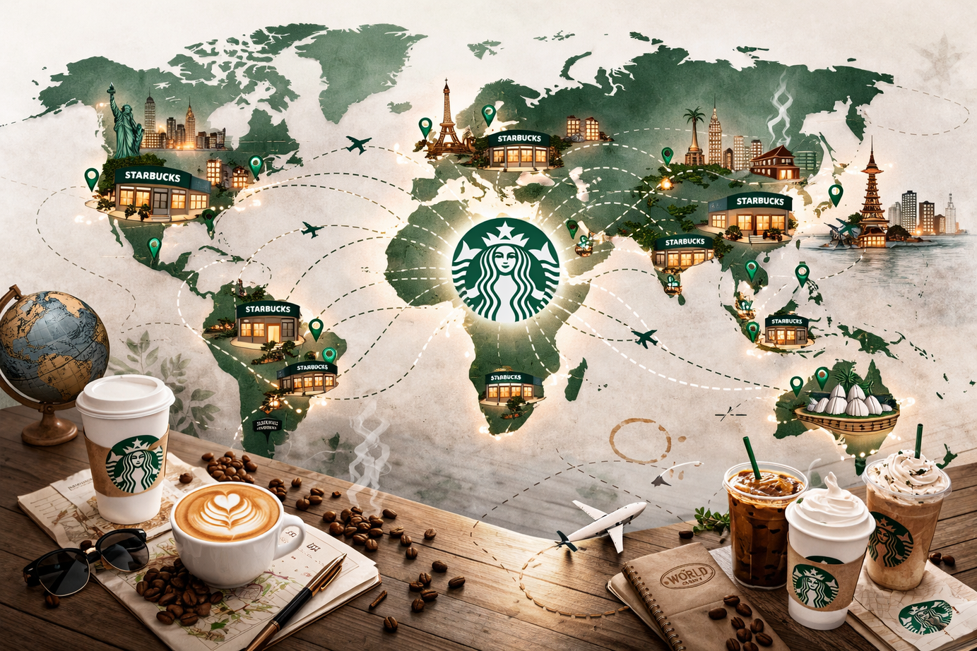
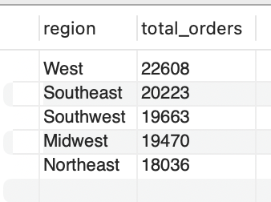
From Beans to Behavior: Understanding Demand
Borcelle
Starbucks
Whether we like to admit it or not, Starbucks is one of the most recognizable coffee brands on the planet-- Everywhere you go, you can almost always count on there being a Starbucks.
Which region of the world has the strongest demand and where are the most orders being placed?
Click Here

Slide 18
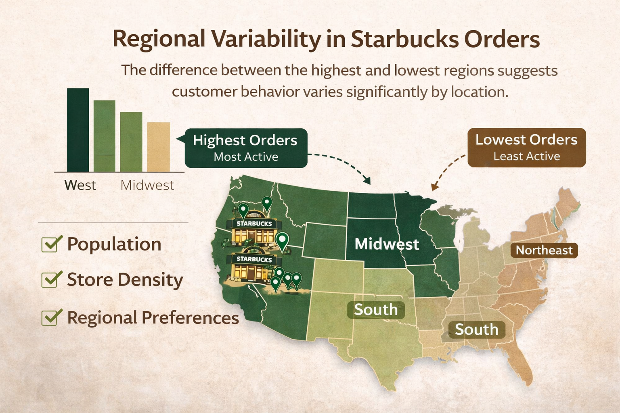
What does this mean?
Borcelle
The difference between the highest and lowest regions suggests that customer behavior varies significantly by location, which could be influenced by factors like population, store density, or regional preferences.
The West region generates the highest number of orders, indicating it is the most active market, while the Northeast has the lowest activity.

Slide 19
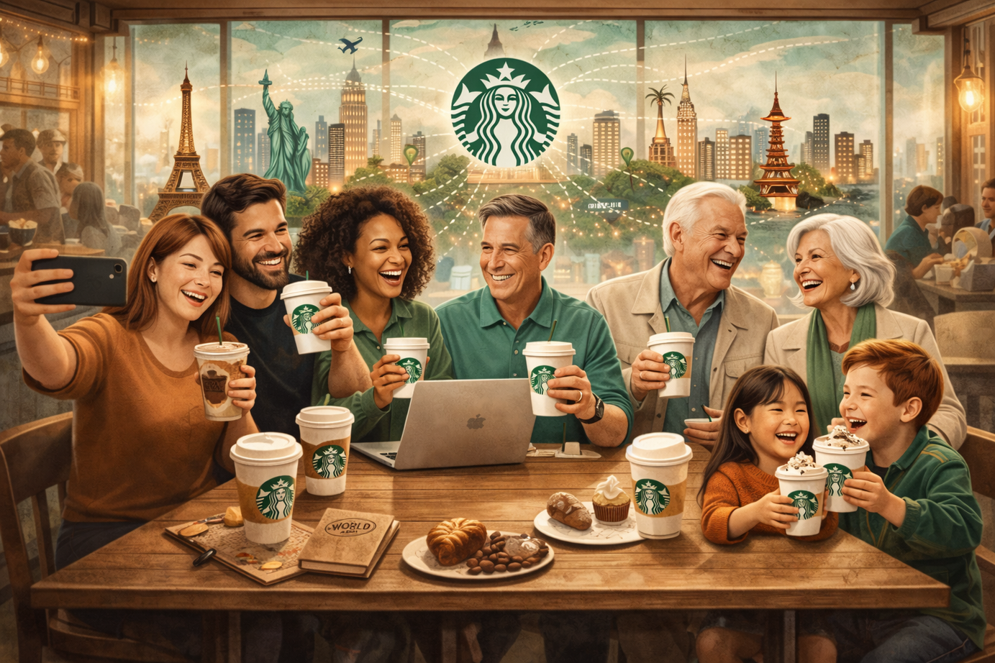
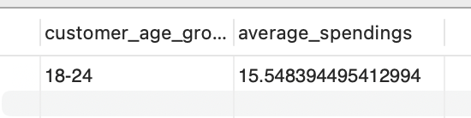
Grounds for Connection
Borcelle
Everyone loves coffee, but different age groups often have different spending habits, preferences, and levels of engagement.
Which age groups contribute the most value, and what does that reveal about differences in customer behavior?

Slide 20
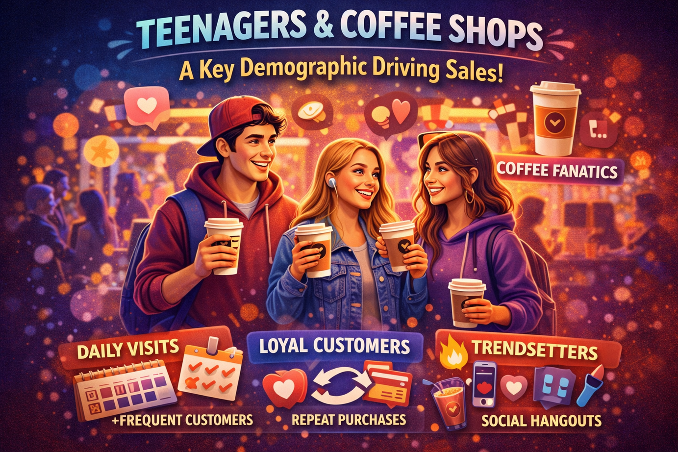
What does this mean?
Borcelle
The 18–24 age group is not just spending the most — they represent a high-value, behaviorally important customer segment that is likely driving trends, product popularity, and repeat purchases.
Their higher average spending suggests they are more engaged with Starbucks offerings, potentially purchasing premium, customized, or multiple items per visit.

Slide 21
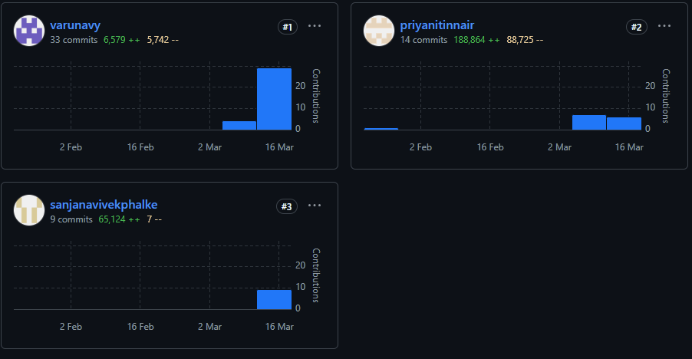
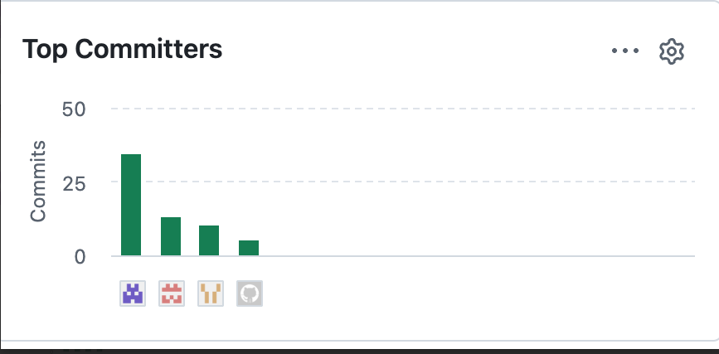
Borcelle
Starbucks
GitHub Link: priyanitinnair/Data-201-Group-Project

Slide 22
Borcelle
Starbucks
Thank You
Next Slide

